Slide 1


Externship - Artificial Intelligence and Deep Learning with Python - VIT
Team
Dense Eclipse
Project
Smart Mathematics Tutor

Slide 2





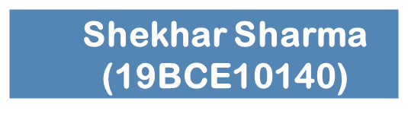


Group Members
Amman Aggarwal
(19BCG10057)
Project
Smart Mathematics Tutor using IBM Watson
Akshat Sharma
(19BCE10147)
Guided By -
Pradeepthi Duggaraja
Neelangshu Nath
(19BCE10224)
Prateek Verma
(19BCE10358)

Slide 3
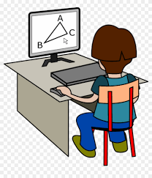
INTRODUCTION
Nationally, the average age at which kids get a phone of their own is 10.3 years. One thing experts agree on is that later is better. Once you open the door, it can be very difficult to close. A 2016 study found that most kids are getting their first social media account between the ages of 10 and 12. This Ich will ultimately lead to unproductive work. Due to lack of interactive learning students doesn't show much interest in learning things. Interactive Learning is a pedagogical approach that incorporates social networking and urban computing into course design and delivery. Interactive Learning has evolved out of the hyper-growth in the use of digital technology and virtual communication, particularly by students. Beginning around 2000, students entering institutes of higher education have expected that interactive learning will be an integral part of their education. The use of interactive technology in learning for these students is as natural as using a pencil and paper were to past generations.
Smart Maths tutor system is a web based graphical user interface where a user gets to draw shapes of mathematical figures such as square, triangle, circle etc for which the output would be related formulas to the drawn figure.

Slide 4


OBJECTIVE
The aim of our project is to create tutoring assistant which will prove to be effective in helping Math students to practice shape recognition exercises. For the assistant to provide the needed guidance to a student who are learning to recognise the shapes, it is necessary to take into consideration both the shape that is needed to be recognised, as well as the name of the shape proposed by the learner.
This tutoring assistant will use a shape generator designed to test the knowledge of the student. This shape generator is created by our team to form different shape so that the students can try guess the name of the shapes and find if their answer was correct or not which will help them build their knowledge in an easy way.

Slide 5
PROPOSED WORK AND METHODOLOGY:
CNN: A convolutional neural network is a class of deep neural networks, most commonly applied to analyzing visual imagery.
Opencv – It is an Open Source Computer Vision Library which are mainly used for image processing, video capture and analysis including features like face detection and object detection
Flask: Flask is a popular Python web framework, meaning it is a third-party Python library used for developing web applications .
Tkinter : It is the standard Python interface to the Tk Graphical User Interface toolkit
WEB Page - HTML and CSS is used build home page and About page of the website

Slide 6
NOVELTY OF THE PROJECT
The IT system has revolutionized the field of mathematics. In this fast-paced world of mathematics, it is a daunting task to manage a classroom. Smart Mathematics Tutor is a computer or web based system that predicts of the shape as well as provides the formula for that shape.
This system or software will help in making the whole functioning paperless and smart. It integrates all the information regarding shapes and formula into one software.

Slide 7
Real Time Usage
Tracking objects
A Shape detection framework is additionally utilized in tracking the shapes/objects, for instance tracking a ball during a match in the football world cup, tracking the swing of a cricket bat, tracking an individual in a video.Object tracking has an assortment of uses, some of which are surveillance and security, traffic checking, video correspondence, robot vision and activity.
People Counting
Shape detection can be additionally utilized for People counting. It is utilized for dissecting store execution or group measurements during festivals. These will, in general, be progressively troublesome as individuals move out of the frame rapidly (likewise in light of the fact that individuals are non-inflexible objects).

Slide 8
HARDWARE AND SOFTWARE REQUIREMENT
Minimum Requirements:
A pc/laptop of i3 processor and RAM 8gb so that Tensorflow and Keras can work on the device.
Recommended:
A pc/laptop of i5 processor and RAM 12gb or more so that Tensorflow and Keras can work properly on the device with the help of GPU.

Slide 9

CNN
Convolutional neural network is one of the main categories to do images recognition, images classifications. Objects detections, recognition faces etc., are some of the areas where CNNs are widely used.

Slide 10

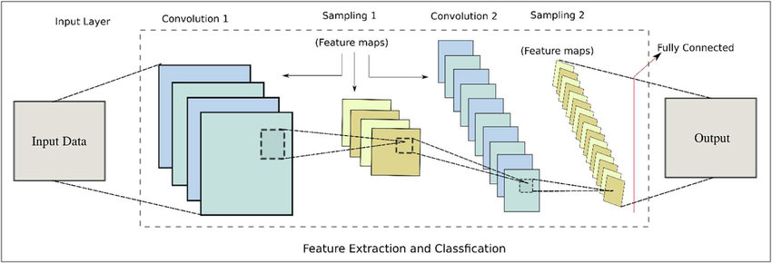
CNN Model Architecture Diagram

Slide 11
Project Flow
User interacts with the UI (User Interface) to launch the tutor.
Then in the GUI we will be drawing a shape.
And finally, with the help of our model we will be predicting and using opencv to showcase the respective formula.
To accomplish this, we have completed all the activities and tasks listed on next slide.

Slide 12
Data Collection
ML depends heavily on data, without data, it is impossible for a machine to learn. It is the most crucial aspect that makes algorithm training possible. In Machine Learning projects, we need a training data set. It is the actual data set used to train the model for performing various actions.
Our dataset contains three classes: 'circle', 'square' and 'triangle'
We use the shape dataset from this link :
https://drive.google.com/drive/folders/1LB1i53cnWHlmIEnEI2C3gtYALTXX4Awa

Slide 13
2. Image Preprocessing
Import the ImageDataGenerator library
from tensorflow.keras.preprocessing .image import ImageDataGenerator
Configure ImageDataGenerator class
train_datagen = ImageDataGenerator(rescale = 1./255, shear_range = 0.2, zoom_range = 0.2, horizontal_flip = True)
test_datagen = ImageDataGenerator(rescale = 1./255)
Apply ImageDataGenerator functionality to Trainset and Testset
x_train = train_datagen.flow_from_directory(r"D:\Smart Mathematics Tutor\Dataset\train",target_size = (64,64),batch_size = 32,class_mode = "categorical")
x_test = test_datagen.flow_from_directory(r"D:\Smart Mathematics Tutor\Dataset\test",target_size = (64,64),batch_size = 32,class_mode = "categorical")

Slide 14
3. Model Building
Importing The Model Building Libraries
import pandas as pd
import numpy as np
from tensorflow.keras.models import Sequential
from tensorflow.keras.layers import Dense, Convolution2D, MaxPooling2D, Flatten, Dropout
Initializing The Model
model = Sequential()
Adding CNN Layers
model.add(Convolution2D(32,(3,3),input_shape = (64,64,3)))
model.add(MaxPooling2D((2,2)))
model.add(Flatten())
Add Dense Layer
model.add(Dense(units = 128, kernel_initializer= "random_uniform",activation = "relu"))
model.add(Dense(units = 3 , kernel_initializer= "random_uniform",activation = "softmax"))

Slide 15
4. Configure The Learning Process and train the model
Compiling the model
model.compile(optimizer= "adam",loss = "categorical_crossentropy" , metrics =["accuracy"])
Fitting the model
model.fit_generator(x_train,steps_per_epoch = 342 , epochs = 100 , validation_data = x_test,validation_steps = 10)
Saving the Model
model.save("shapes.h5")

Slide 16
5. Test The Model
Predicting our result
from tensorflow.keras.models import load_model
from tensorflow.keras.preprocessing import image
model = load_model("shapes.h5")
img=image.load_img(InputImg,target_size=(64,64)) # load and reshaping the image
x=image.img_to_array(img)#converting image to array
x=np.expand_dims(x,axis=0)
pred=model.predict_classes(x)
print(pred)
index=['circle', 'square', 'triangle']
result=str(index[pred[0]])

Slide 17
Module Description
1. HOME:
It is the front page of website which consist different animated shapes and bit of briefing of what function the website is going to perform.From this page we can navigate to About and Learn Shape page.
2. About:
This page gives briefing about how the smart maths tutor system operates and this page also have the option for testing the smart maths tutor system.From this page we can navigate to About and Learn Shape page.
3. Learn Shape:
This page directly lets you test smart tutor system where you can draw any shape and find detail about it.

Slide 18
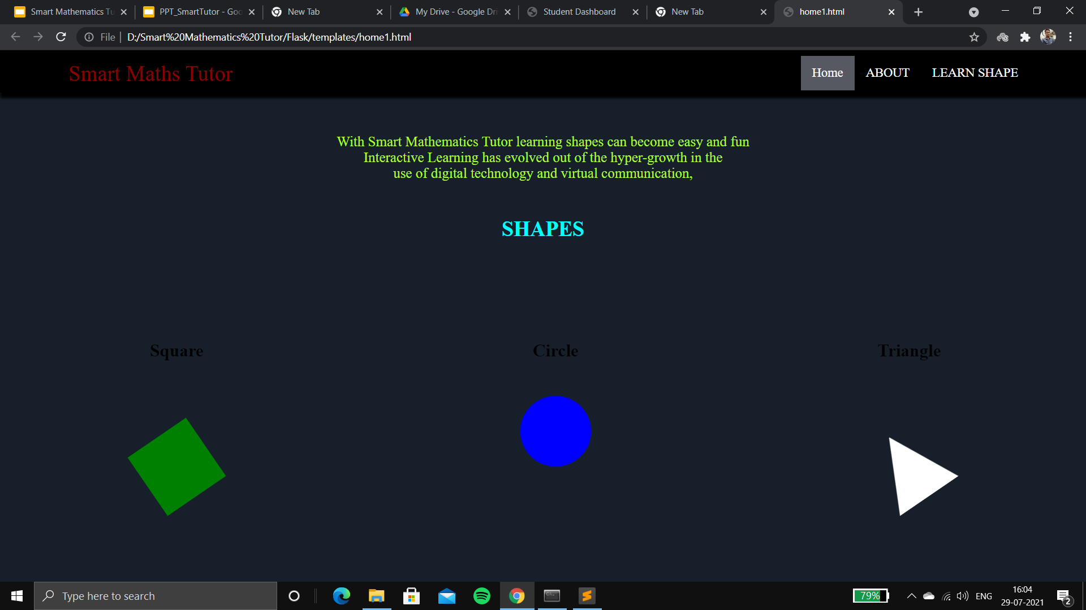
Result
Home Page

Slide 19
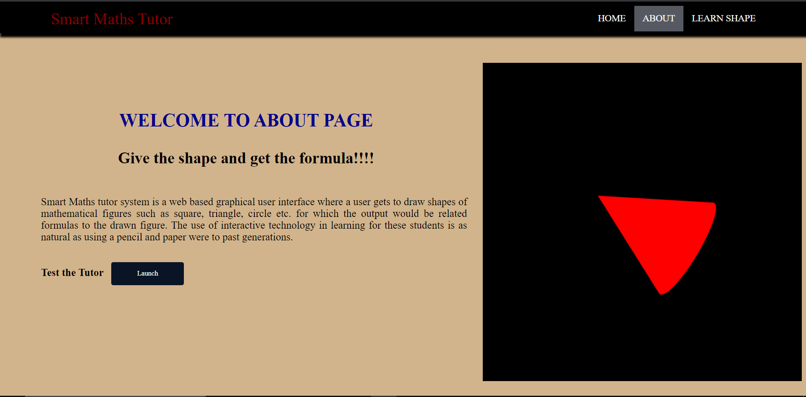
About Page

Slide 20
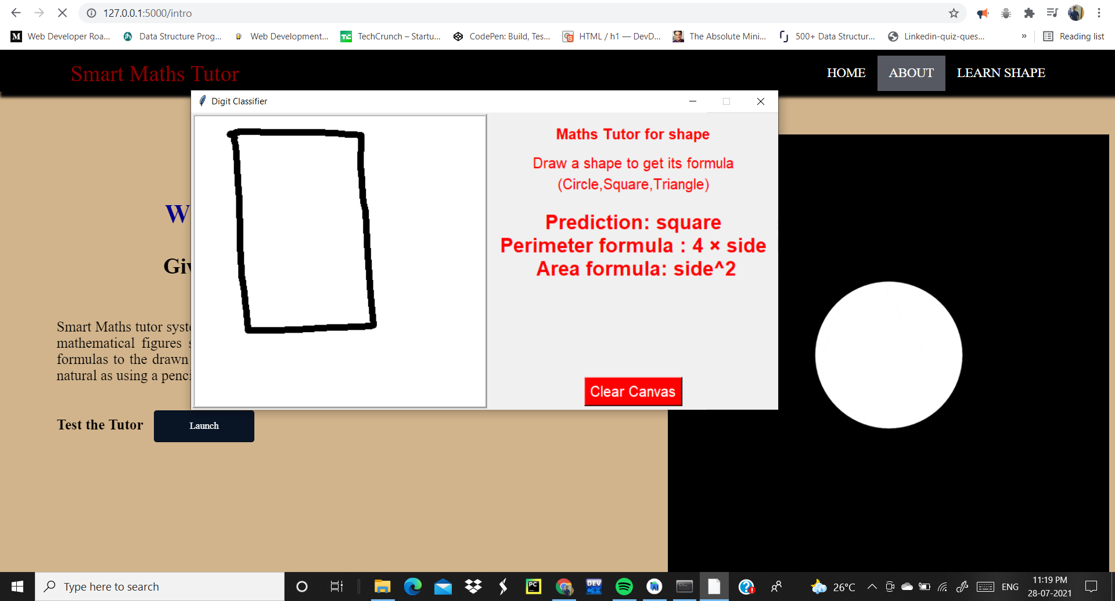
Project Output : Tk window prediction

Slide 21


REFERENCES
Youtube
https://youtu.be/kqBmsLvWU14

Slide 22
Thank You

